Slide 1
Debugging in Android

Slide 2
What is Debugging
Process of detecting and removing of existing and potential error
Detect
Fix

Slide 3
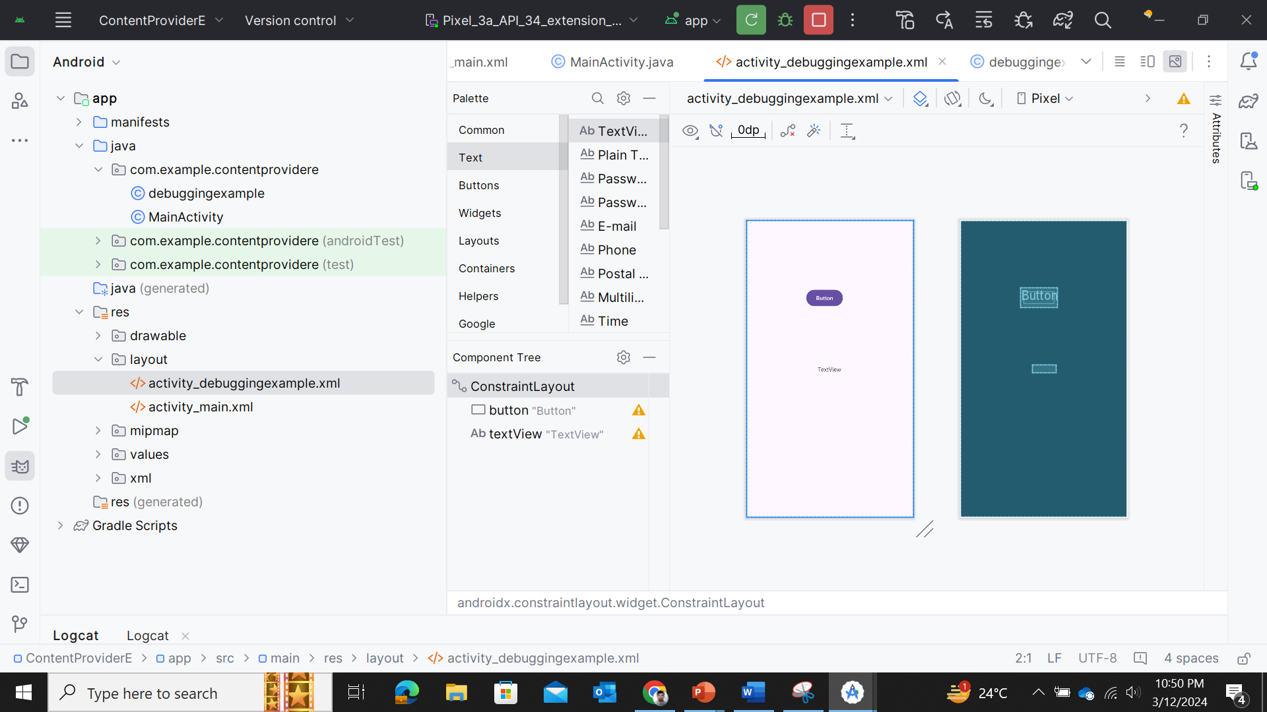

Slide 4
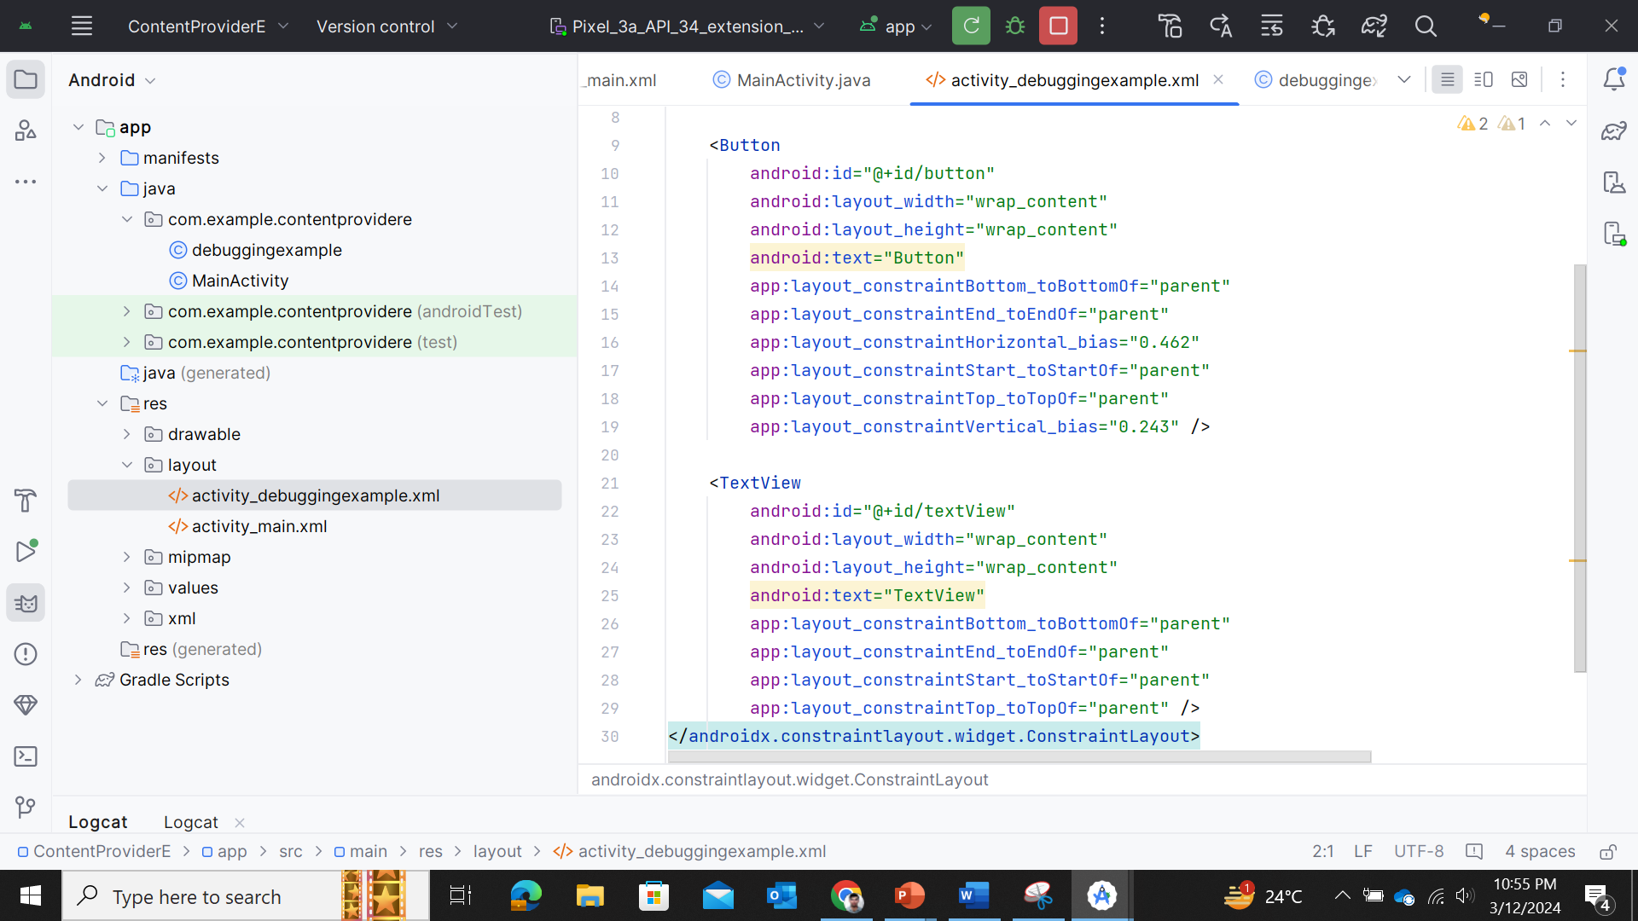

Slide 5
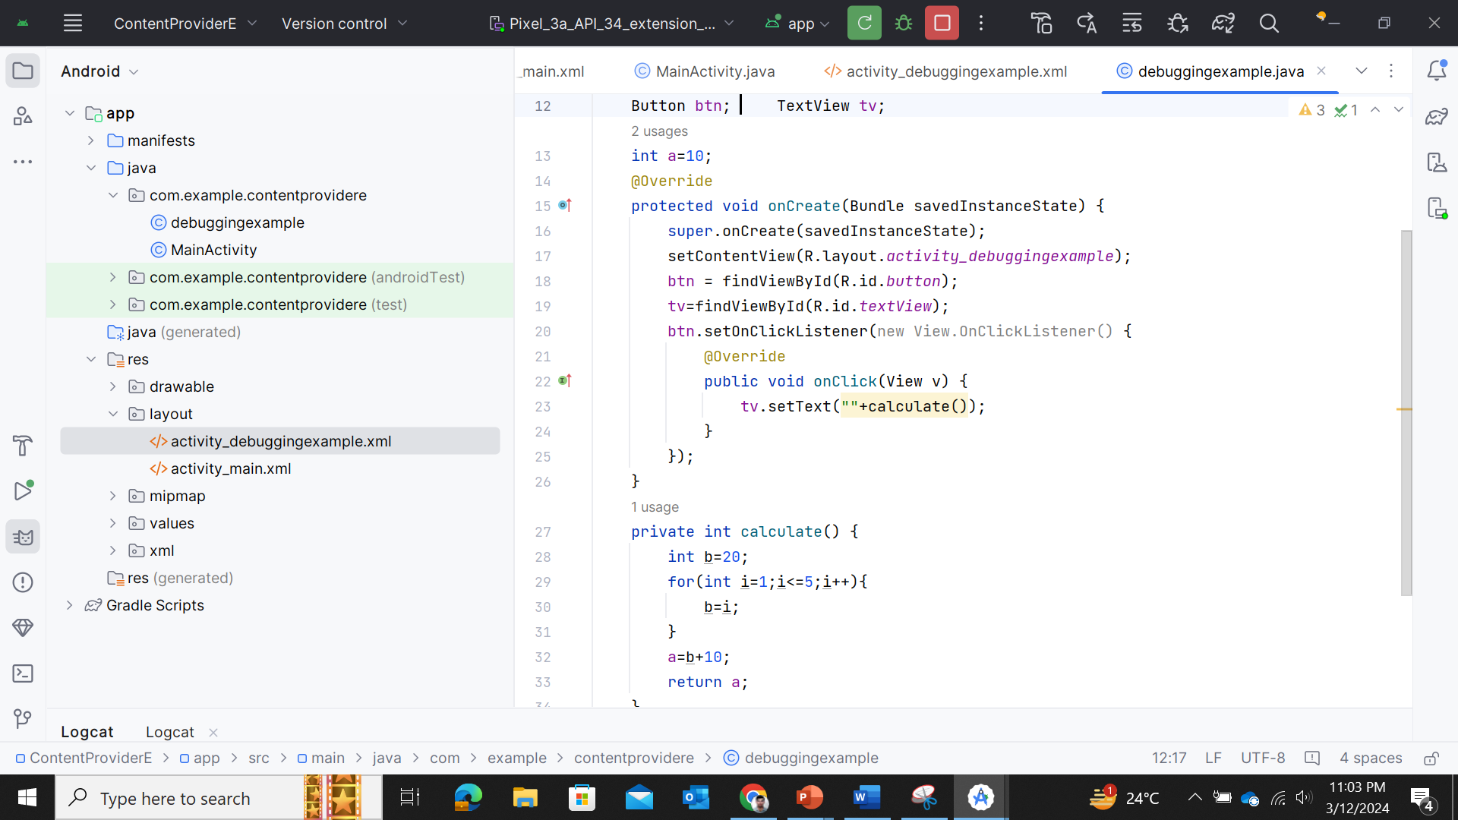

Slide 6
